Slide 1
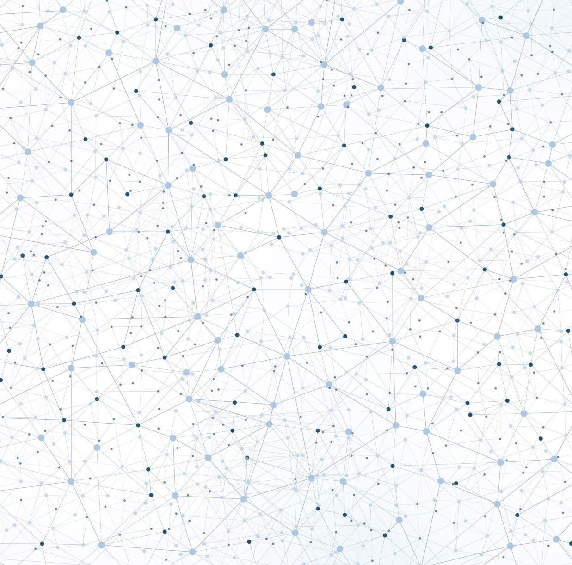
Fine-Tuning Pre-Trained Models
(NER & Classification Focus)
Notes:
Theme: "Specialization over Generalization: Building Efficient AI for the Edge."

Slide 2
The "Why" and "What" of Fine-Tuning

Slide 3
Building a foundation model
Pre-training
(un-supervised)
Instruction tuning (SFT)
Alignment tuning (RLHF, DPO)
Generic LLM/SLM
Massive amount of generic, unlabeled data
Instruction-response data,
task-specific data,
other annotated data
Human preference data,
reward model data, preference score data
Pre-training
Post-training
Watch BRK 150: Microsoft Build: https://www.youtube.com/watch?v=hw6-rrYtUy8
Notes:
Adapted from BRK 150

Slide 4
Why fine-tune?
Enhance performance and accuracy
Cost reduction and efficiency
Lower latency
Risk mitigation
Domain-specific customization
Task-specific optimization
Reduced token consumption
Efficient resource utilization
Smaller, faster models
Fewer tokens – faster responses
Reduce bias and improve fairness
Avoid hallucinations
BRK 150 deck: https://lnkd.in/ga7c2mj3 & Code: https://lnkd.in/g2-c-g_G
Notes:
Adapted from BRK 150

Slide 5
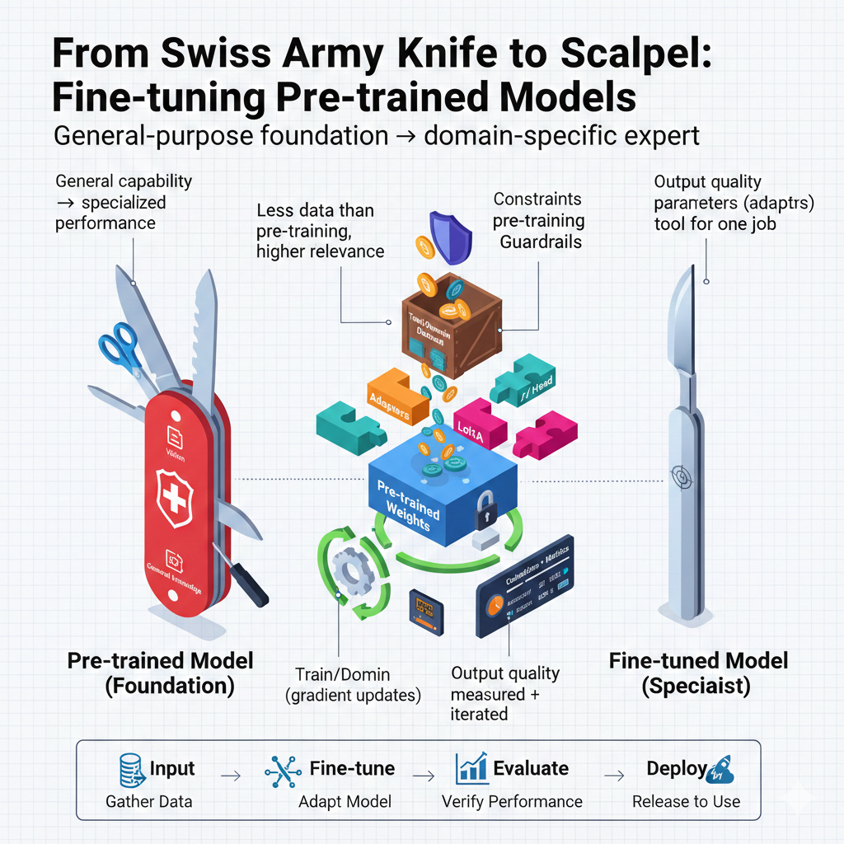
Fine-Tuning Pre-Trained Models Turning Generalists into Specialists (NER & Classification)
Notes:
A large, generic Swiss Army Knife (The Pre-trained Model) transforming into a precise surgical scalpel (The Fine-Tuned Model).

Slide 6
The limits of Prompt Engineering
The Problem:
Cost: Sending long prompts to GPT-* is expensive at scale.
Latency: Large models are slow. A robot needs to react in milliseconds.
Privacy: You can't send sensitive data to a public API.
Formatting: Prompts sometimes fail to follow strict JSON schemas.
The Solution: Fine-Tuning. Teaching a smaller, faster model to do one thing perfectly.

Slide 7
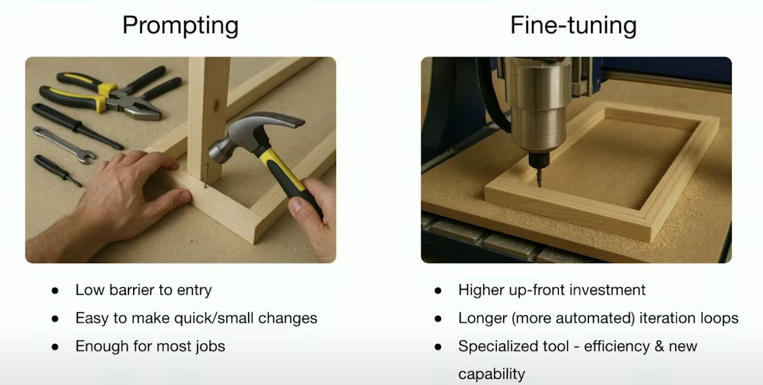
Image Credit: YT OpenAI: https://www.youtube.com/watch?v=JfaLQqfXqPA

Slide 8
Fine-tuning a foundation model
Instruction tuning (SFT)
Alignment tuning (RLHF, DPO)
Generic LLM/SLM
Fine-tuned LLM/SLM
Language capability
Reasoning capability
World knowledge
Chat
Instruction-following
Coding
etc.
Adapted with your data, for your use case
Instruction-response data,
task-specific data,
other annotated data
Human preference data,
reward model data, preference score data
fine-tuning
BRK 150 deck: https://lnkd.in/ga7c2mj3 & Code: https://lnkd.in/g2-c-g_G
Notes:
Adapted from BRK 150 – What is it?

Slide 9
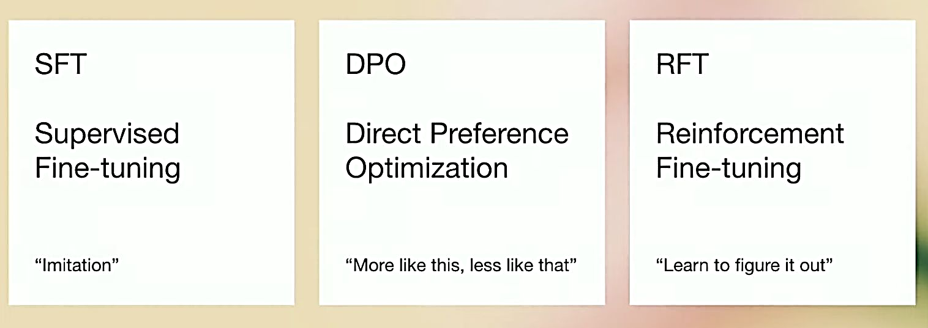
SFT, DPO & RFT
YT OpenAI: https://www.youtube.com/watch?v=JfaLQqfXqPA
Reinforcement Fine-tuning: https://github.com/openai/openai-cookbook/tree/main/examples/fine-tuned_qa
Guide to DPO: https://github.com/openai/openai-cookbook/blob/main/examples/Fine_tuning_direct_preference_optimization_guide.ipynb

Slide 10
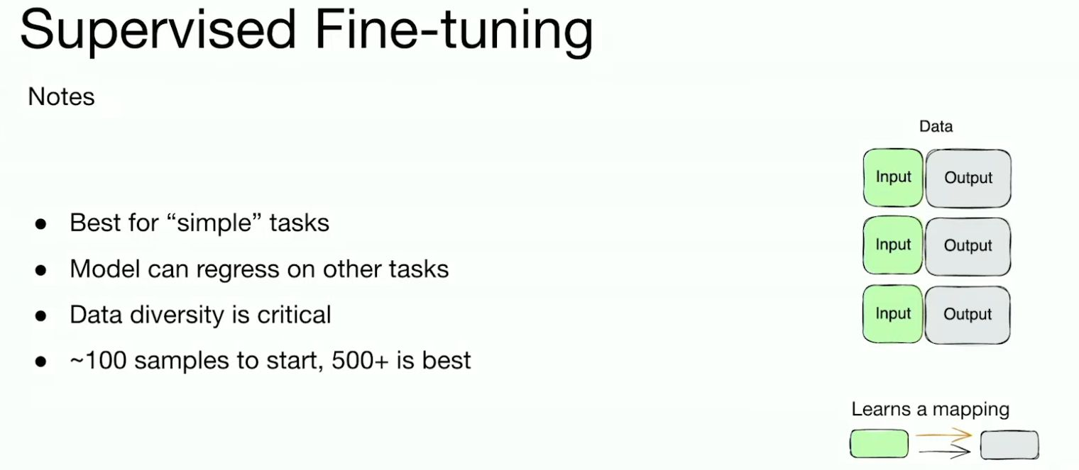
Image Credit: YT OpenAI: https://www.youtube.com/watch?v=JfaLQqfXqPA

Slide 11
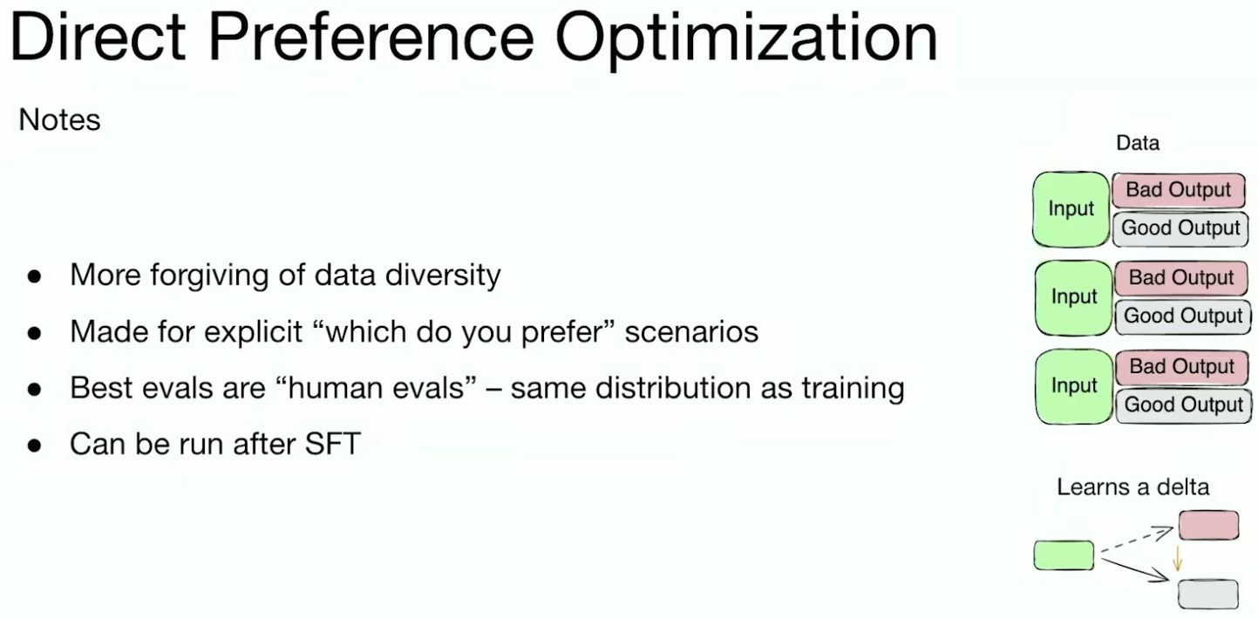
Image Credit: YT OpenAI: https://www.youtube.com/watch?v=JfaLQqfXqPA

Slide 12
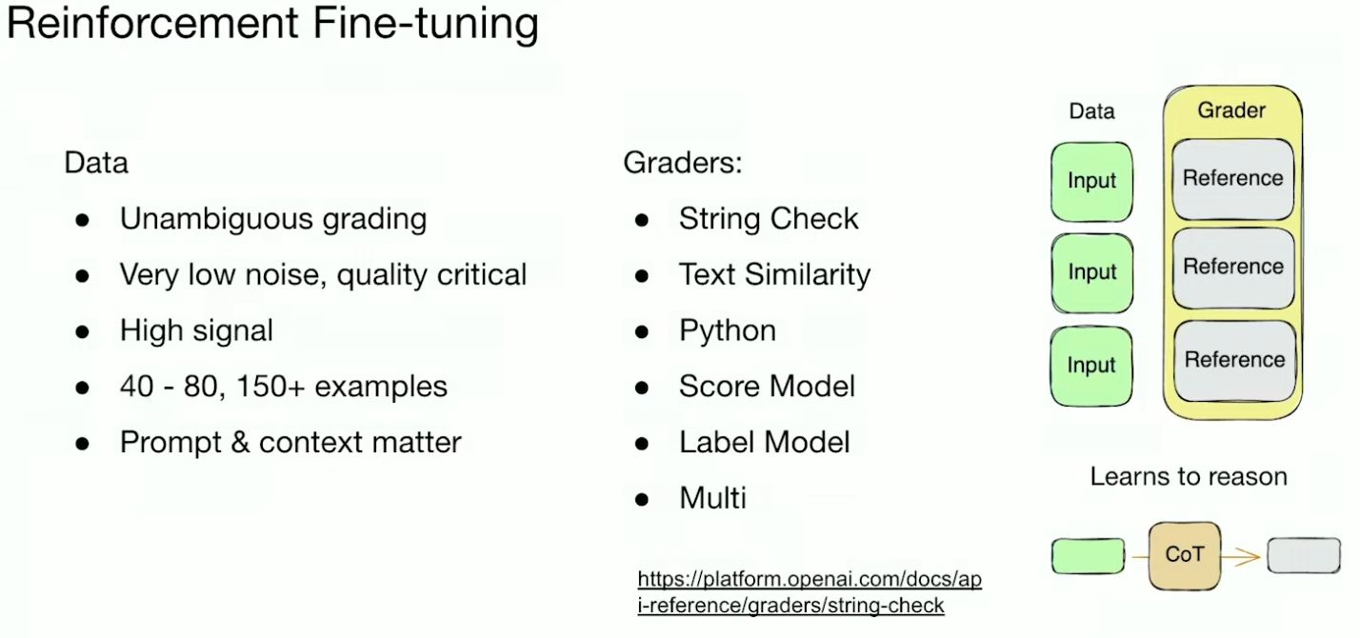
Image Credit: YT OpenAI: https://www.youtube.com/watch?v=JfaLQqfXqPA

Slide 13
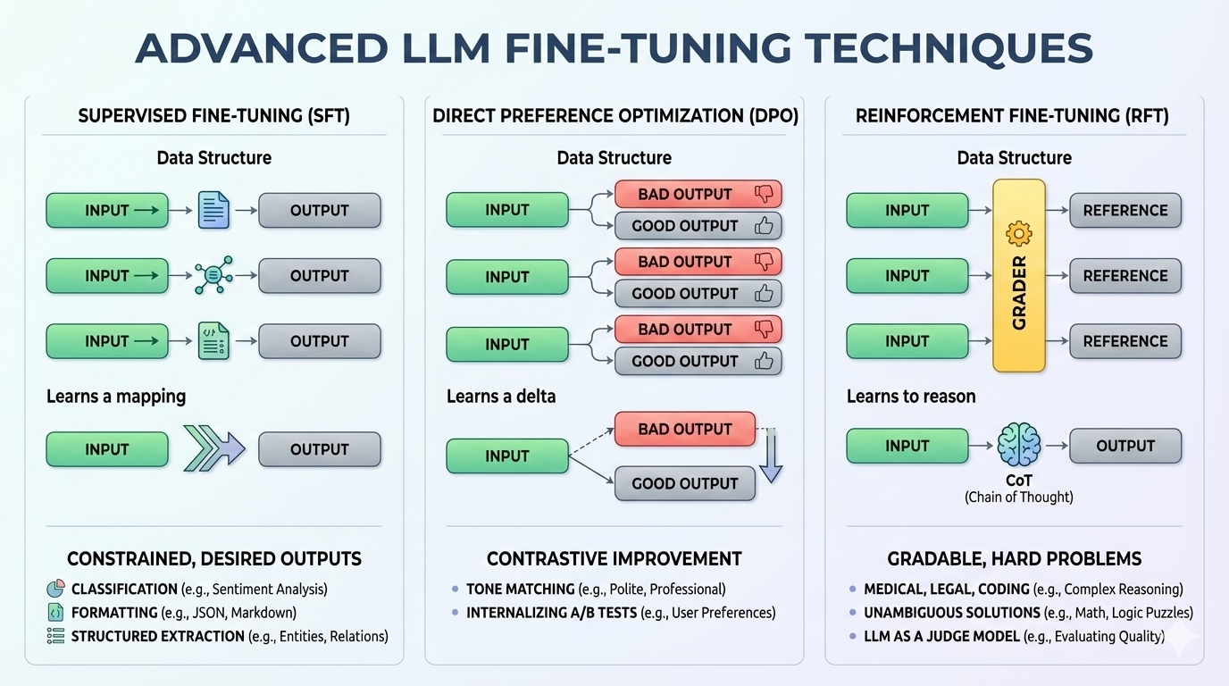
Image Credit: YT OpenAI: https://www.youtube.com/watch?v=JfaLQqfXqPA recreated with Nano Banana Pro

Slide 14
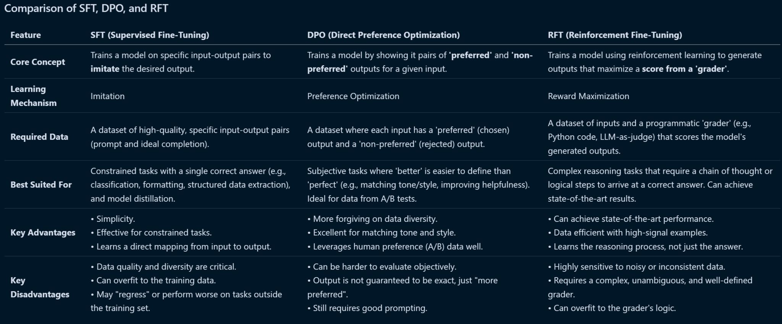
Notes:
Take this image and pass it through an LLM and do a deep research on it.

Slide 15

A look ahead on PEFT (Parameter-Efficient Fine-Tuning) & LORA (Low-Rank Adaptation)
Bridge to future modules.
Question: What if the model is too big to fine-tune on my laptop (like Llama 3)?
Preview: We don't tune all parameters. We use PEFT (Parameter-Efficient Fine-Tuning) to tune only 0.1% of the weights. (We will discuss this in advanced Generative AI modules).

Slide 16
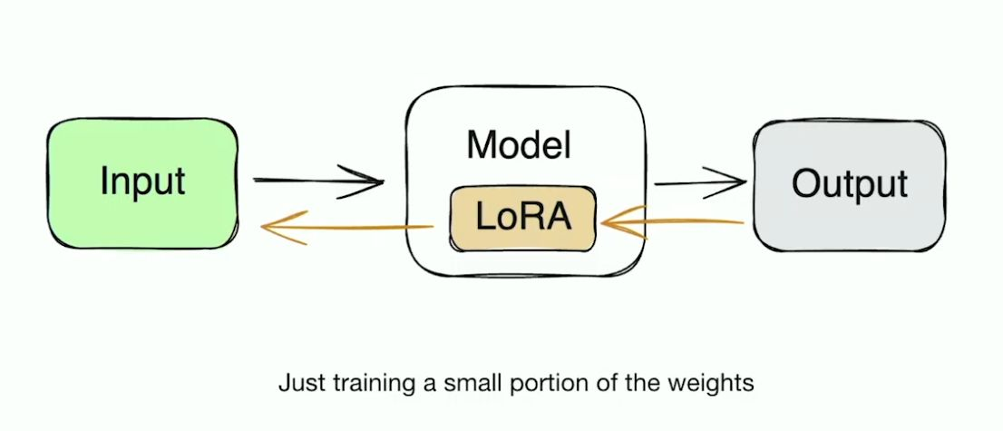
Microsoft arxiv paper on LoRA: https://arxiv.org/pdf/2106.09685
Image Credit: YT OpenAI: https://www.youtube.com/watch?v=JfaLQqfXqPA
Notes:
Do a quick look up in AI

Slide 17
Distillation vs Fine-tuning
Knowledge Distillation: A Student Model learns from a teacher model by mimicking its outputs (often soft logits or intermediate representation). Goal: Compress knowledge from a larger model into smaller one while preserving performance.
Typical Use case: Model Size Reduction
Fine-Tuning (RFT/DPO/SFT): These Adjust the weights of a model using labeled data or preference signals. Goal: Align the model with desired behaviors or domain-specific tasks. They do not involve transferring knowledge from a teacher to student model.
Typical Use case: Refer earlier slides.

Slide 18
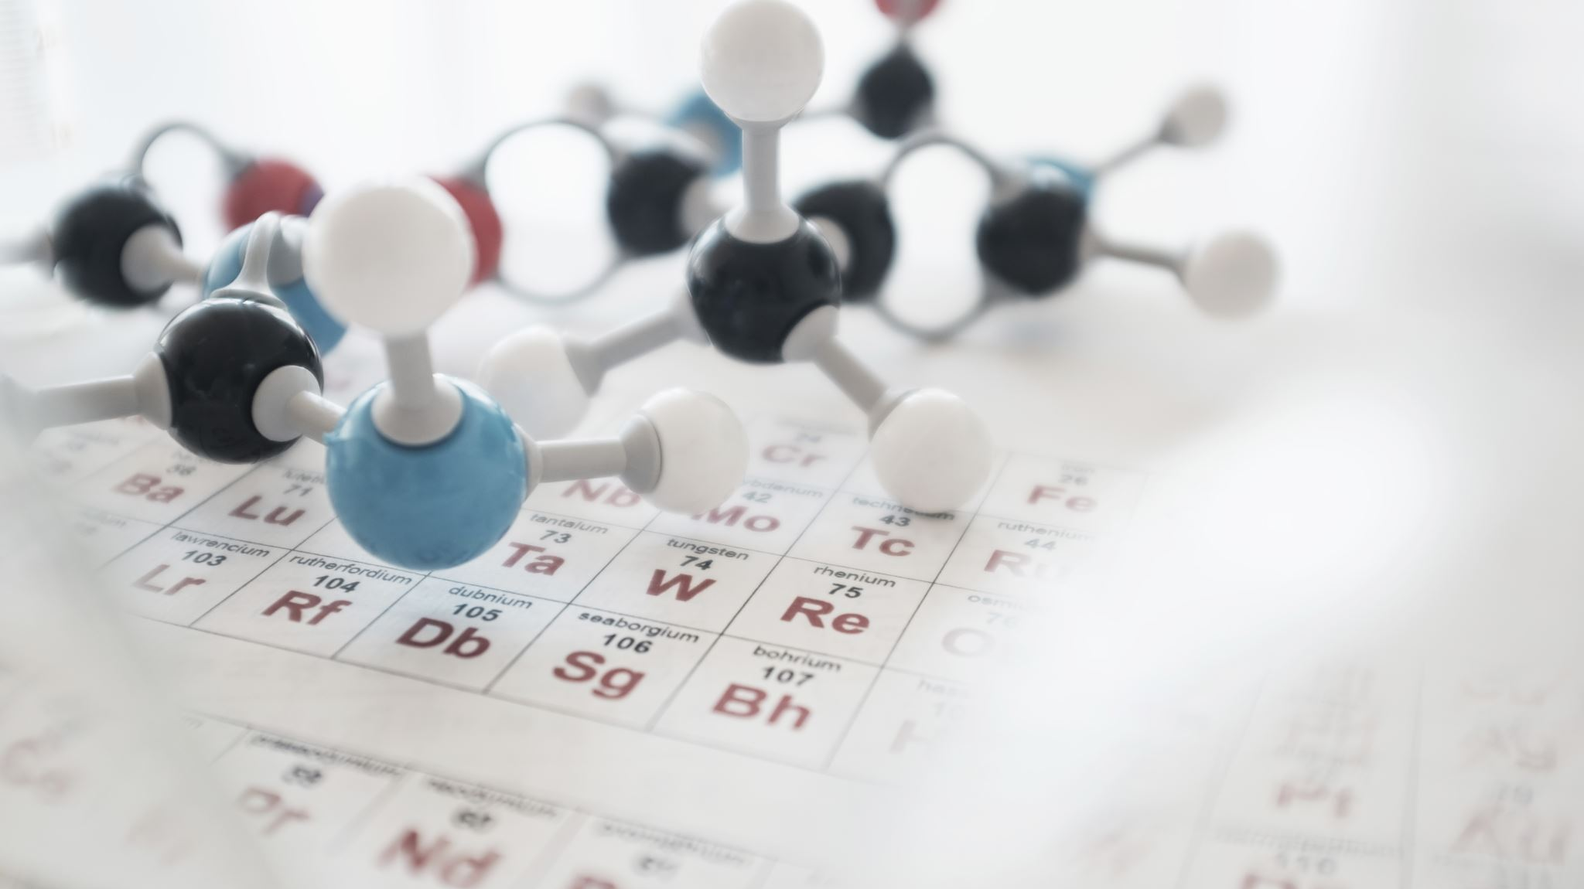
NLP Lab Exercise Fine-tuning DistilBERT using HuggingFace Trainer and Google Colab

Slide 19
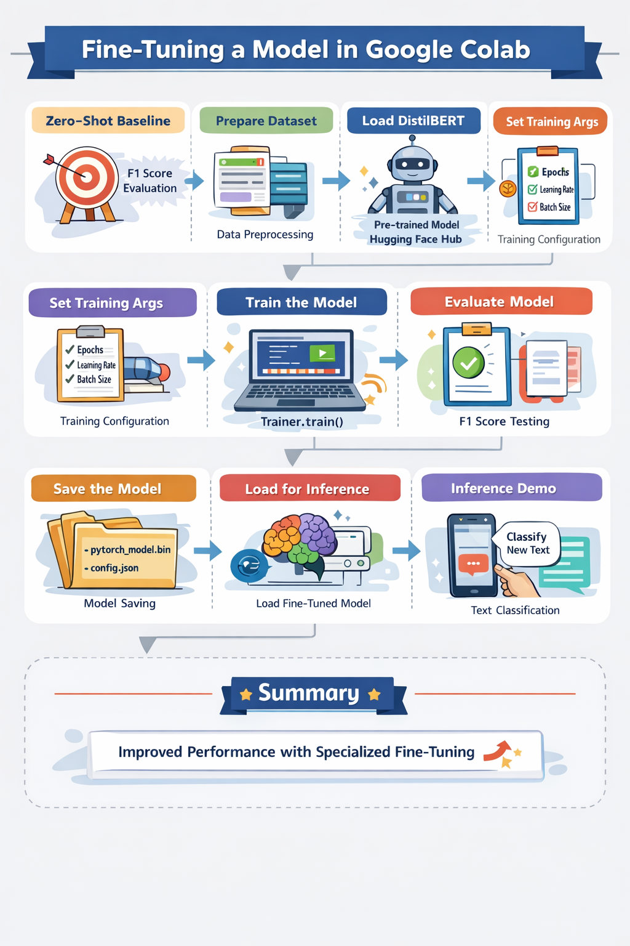
Notes:
Refer Google Colab Notebook

